Slide 1

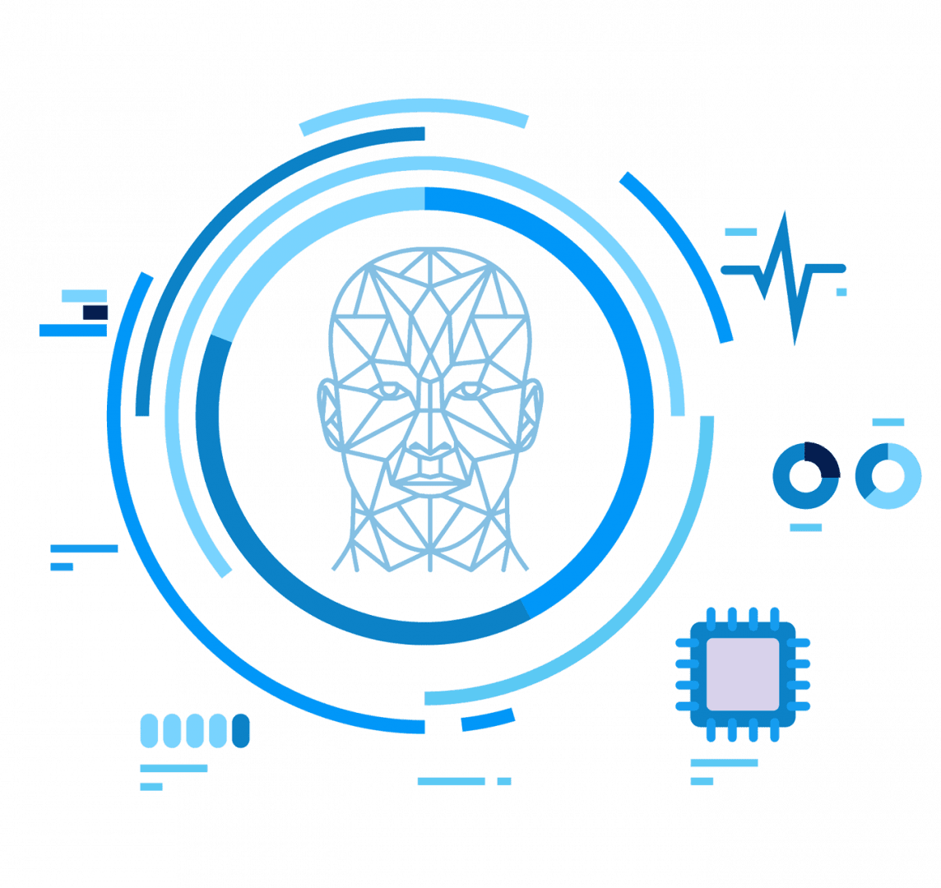
Object Detection for Autonomous Driving (Virtual Simulator)
Guide
Presented by
Dr. Lekshmi K
Professor - Higher Academic Grade
SCOPE
Vellore Institute of Technology, Chennai
Vinayak Kumar Singh
23MCA1030

Slide 2

PROBLEM STATEMENT
LITERATURE REVIEW
Contents
OBJECTIVES
PROPOSED SOLUTION
ARCHITECTURE & DATASET
MODULES IDENTIFIED & DESCRIPTION
.

Slide 3
PROBLEM STATEMENT
Develop a robust real-time object detection system using a virtual simulator for self-driving cars to accurately identify and localize vehicles on the road.
Address challenges such as varying lighting conditions, diverse vehicle orientations, and complex movement dynamics while ensuring efficient model performance.
The goal is to achieve high detection accuracy with minimal latency, facilitating smooth and responsive operation in the simulated environment.
Notes:
Innovate gesture-based interaction in virtual reality by developing a system that seamlessly integrates deep learning-based recognition with real-time hand tracking, aiming to redefine user experiences and accessibility across various domains.
To overcome limitations in existing gesture recognition approaches such as lightning and clutter background, focusing on robustness during the recognition phase.
Desire for seamless and hands-free control of multimedia playback in various contexts.
To Improve accessibility, especially for individuals with physical disabilities, through advancements in gesture recognition systems

Slide 4
RESEARCH OBJECTIVES
Create a vehicle detection model capable of accurately identifying and tracking cars in real-time using the Udacity Self-Driving Car Simulator.
Enhance the model's ability to handle diverse conditions, including fluctuating lighting, varied vehicle positions, and dynamic motion, while maintaining efficient processing.
Achieve a balance between low latency and high detection accuracy to ensure reliable performance suitable for real-time autonomous driving tasks within the simulation.
Notes:
Get more varied pictures of hand movements by pretending to do different gestures or asking others to help. This helps the computer understand gestures better.
Teach the computer to recognize tricky gestures by showing it with lots of examples.
Make it easier for the computer to understand how you move your hand.
Help the computer tell the difference between similar hand movements by showing it when and where you use each gesture.

Slide 5
LITERATURE REVIEW
S.No | TITLE(YEAR) | TECHNOLOGY USED | PROBLEM SOLVED | OBSERVATIONS
1 | Vehicle-in-Virtual-Environment (VVE) Method for Autonomous Driving System Development, Evaluation and Demonstration | The paper utilizes the Vehicle-in-Virtual-Environment (VVE) method for autonomous driving system development and testing. | It addresses the safety, cost, and inefficiency issues of testing autonomous vehicles on public roads. | The VVE method provides a safer, more efficient, and cost-effective approach to test autonomous driving functions in realistic yet controlled scenarios.
2 | Fast and accurate object detector for autonomous driving based on improved YOLOv5 | The paper utilizes an improved YOLOv5 algorithm enhanced by structural re-parameterization and neural architecture search. | It addresses the low detection accuracy of small vehicles and pedestrians in complex traffic environments. | The proposed model significantly improves detection accuracy and processing speed, making it a promising solution for autonomous driving applications.

Slide 6
S.No | TITLE(YEAR) | TECHNOLOGY USED | PROBLEM SOLVED | OBSERVATIONS
3 | Real-Time Object Detection Performance of YOLOv8 Models for Self-Driving Cars in a Mixed Traffic Environment | The paper utilizes the YOLOv8 deep learning framework for real-time object detection. | It addresses the challenges of accurately detecting objects in mixed traffic environments for self-driving cars. | The study concludes that YOLOv8 demonstrates robust performance, particularly YOLOv8x, but highlights the need for further improvements to handle complex scenarios effectively.
4 | An improved lightweight small object detection framework applied to real-time autonomous driving | The paper utilizes an improved YOLOv5 model with architectural modifications and kernel pruning techniques for small object detection. | It addresses the challenge of accurately detecting small objects, such as traffic signs and lights, in autonomous driving environments. | The proposed framework significantly enhances detection accuracy and speed while minimizing computational complexity, making it suitable for real-time applications in autonomous vehicles.
5 | Multi-Modal 3D Object Detection in Autonomous Driving: A Survey | The paper focuses on multi-modal sensor fusion, specifically integrating camera and LiDAR data for 3D object detection in autonomous driving. | It addresses the challenges of effectively fusing diverse sensor inputs to enhance perception accuracy in complex driving environments. | The survey highlights the evolution of fusion techniques and emphasizes the need for continued research to overcome existing challenges in multi-modal 3D object detection.

Slide 7
S.No | TITLE(YEAR) | TECHNOLOGY USED | PROBLEM SOLVED | OBSERVATIONS
6 | End-to-End Planning by Vision-language Model for Autonomous Driving on Carla Simulator | The paper employs a vision-language model with an auto-regressive transformer decoder for end-to-end autonomous driving planning. | It addresses the challenge of accumulated errors and information loss in traditional module-based autonomous driving systems by integrating planning as a language sequence generation task. | The proposed method achieved state-of-the-art performance on CARLA benchmarks, demonstrating its effectiveness and potential for real-world autonomous driving applications.
7 | Waymax: An Accelerated, Data-Driven Simulator forLarge-Scale Autonomous Driving Research | The paper utilizes a hardware-accelerated, differentiable simulator built on real-world driving data for autonomous vehicle research. | It addresses the challenges of speed and realism in simulating complex multi-agent interactions in autonomous driving scenarios. | Waymax demonstrates significant potential for improving the training and evaluation of autonomous driving systems while minimizing the sim-to-real performance gap
8 | Lane detection based on real-time semantic segmentation for end-to-end autonomous driving under low-light conditions | The paper employs the UET-STDC framework, integrating real-time semantic segmentation and the Zero-DCE++ image enhancement method. | It addresses the challenges of low lane detection accuracy and feature extraction difficulties in low-light driving conditions. | The proposed method significantly improves lane segmentation performance while maintaining real-time processing capabilities, enhancing the safety and efficiency of autonomous driving systems.

Slide 8
S.No | TITLE(YEAR) | TECHNOLOGY USED | PROBLEM SOLVED | OBSERVATIONS
9 | Autonomous Vehicle Simulation With Multi Human Driving Behavior Using Deep Learning | The paper utilizes deep learning techniques, specifically Convolutional Neural Networks (CNN), for autonomous vehicle simulation. | It addresses the challenge of simulating multi-human driving behaviors in autonomous vehicles to improve their decision-making capabilities. | The research demonstrates promising results with a 71% accuracy and suggests further optimization opportunities for enhancing autonomous vehicle performance.
10 | Choose Your Simulator Wisely: A Review on Open-Source Simulators for Autonomous Driving | The paper discusses various open-source simulators for autonomous driving, focusing on their functionalities and performance. | It addresses critical issues related to simulation fidelity, efficiency, and the validity of algorithms developed in these simulators. | The review emphasizes the need for improved realism and standardization in simulators to enhance the development and deployment of autonomous driving technologies.
11 | Autonomous Vehicles Using Udacity’s Self Driving Vehicles Simulator | The paper utilizes machine learning algorithms, specifically convolutional neural networks (CNN) and recurrent neural networks (RNN), for training autonomous vehicle models. | It addresses the challenge of training autonomous vehicles to navigate diverse driving environments effectively. | The study concludes that enhancing image processing and model adaptability is essential for achieving optimal performance in real-time driving scenarios.

Slide 9
S.No | TITLE(YEAR) | TECHNOLOGY USED | PROBLEM SOLVED | OBSERVATIONS
12 | 3D Object Detection for Autonomous Driving: A Comprehensive Survey | The paper utilizes 3D object detection technologies using LiDAR, cameras, and multi-modal sensor fusion for autonomous driving. | It addresses the challenge of accurately detecting and localizing objects in 3D space for reliable perception in autonomous vehicles. | The study concludes that while significant progress has been made, improvements in sensor integration and computational efficiency are crucial for advancing 3D object detection in real-time autonomous driving applications.
13 | MCS-YOLO: A Multiscale Object Detection Method for Autonomous Driving Road Environment Recognition | The paper employs the MCS-YOLO algorithm, incorporating a coordinate attention mechanism and Swin Transformer for enhanced object detection. | It addresses the challenges of low inference speed and accuracy in object detection for autonomous driving environments. | The MCS-YOLO algorithm significantly improves detection performance, achieving higher accuracy and real-time processing capabilities compared to existing models.
14 | Deep Learning-Based Image 3-D Object Detection for Autonomous Driving: Review | The paper focuses on deep learning-based methods for 3-D object detection using monocular and stereo camera images. | It addresses the challenges of obtaining accurate 3-D information from 2-D images in autonomous driving scenarios. | The study highlights the need for improved robustness and performance in 3-D object detection to enhance the safety and reliability of autonomous driving systems.

Slide 10
S.No | TITLE(YEAR) | TECHNOLOGY USED | PROBLEM SOLVED | OBSERVATIONS
15 | Radar-Camera Fusion for Object Detection and Semantic Segmentation in Autonomous Driving: A Comprehensive Review | The paper focuses on radar-camera fusion technology for enhancing perception in autonomous driving. | It addresses the challenges of integrating radar and camera data for improved object detection and semantic segmentation in various environmental conditions. | The review highlights the potential of radar-camera fusion to provide robust and reliable perception systems for autonomous vehicles, paving the way for future research and advancements in this field.

Slide 11
PROPOSED SOLUTION
The project focuses on using a virtual simulator environment to develop and test self-driving car models.
An advanced deep neural network model (NVIDIA architecture) is employed to predict steering angles based on image data.
Enhancements to the model include techniques like dropout, ELU activation function, and behavioral cloning to improve performance.
Notes:
The KITTI dataset is a large-scale dataset of real-world images and sensor data captured from a car, used for tasks like object detection, tracking, and 3D scene understanding.

Slide 12
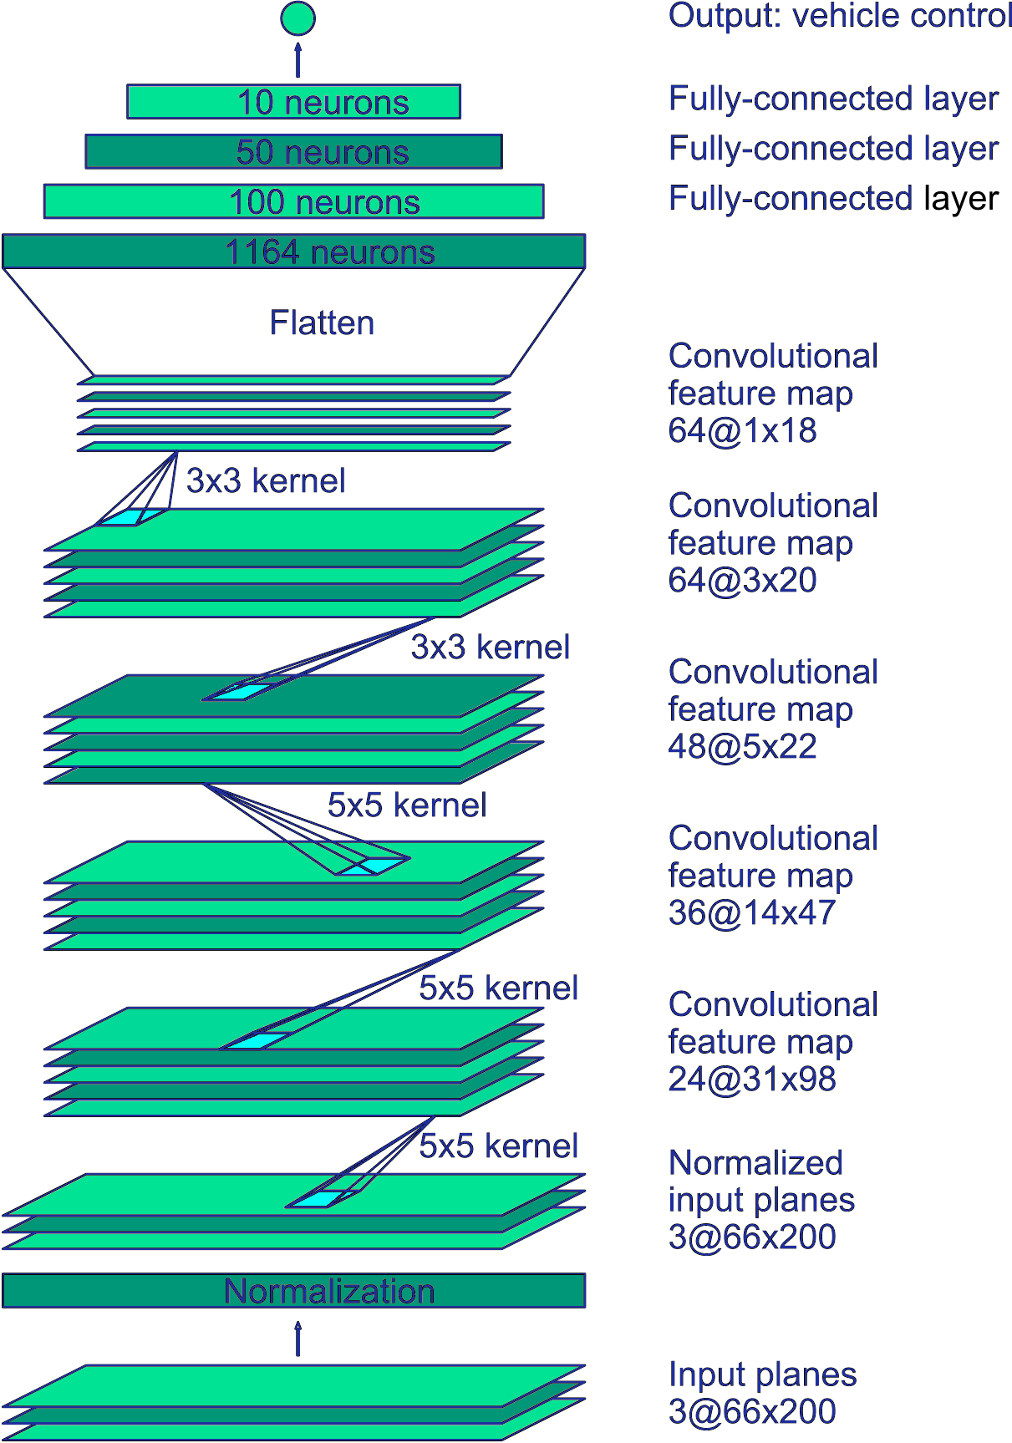
ARCHITECTURE
Transition from LeNet-5 to NVIDIA model due to its capability to handle complex image data and regression tasks.
Consists of multiple convolutional layers with ELU activation functions and subsampling to extract features from images.
Final layers include flattening and fully connected layers to output a predicted steering angle.
Notes:
The KITTI dataset is a large-scale dataset of real-world images and sensor data captured from a car, used for tasks like object detection, tracking, and 3D scene understanding.

Slide 13
DATASET DESCRIPTION
Training data collected from Udacity's simulator with images from multiple camera angles (center, left, right).
Metadata includes steering angles, speed, throttle, and other driving parameters.
Current dataset contains 5386 images, with plans to reduce bias by filtering out instances with steering angle = 0.
Notes:
The KITTI dataset is a large-scale dataset of real-world images and sensor data captured from a car, used for tasks like object detection, tracking, and 3D scene understanding.

Slide 14
MODULE IDENTIFIED
Data Preprocessing Module: Normalizes image data and prepares it for training.
Object Detection Module: Uses convolutional layers for feature extraction from images.
Model Training Module: Implements behavioral cloning techniques for steering angle prediction.
Evaluation Module: Analyzes model performance using validation metrics and drives performance on simulator tracks.
Notes:
The KITTI dataset is a large-scale dataset of real-world images and sensor data captured from a car, used for tasks like object detection, tracking, and 3D scene understanding.

Slide 15
IMPLEMENTATION
Model compiled using Mean Squared Error as the loss function and Adam optimizer for better convergence.
Training process includes data augmentation, dropout layers to reduce overfitting, and hyperparameter tuning.
Regular evaluation and adjustments based on training feedback and performance on simulated tracks.

Slide 16
EVALUATION METRICS
Value Loss (val_loss): Tracks the decrease in loss across epochs during the training phase.
Drive Performance on Track: Generalization capability tested on simulator tracks to measure real-world performance.
Accuracy: Computed as the correctness of the steering angle prediction relative to ground truth data.

Slide 17
GUIDE APPROVAL MAIL SCREENSHOT
To be added…

Slide 18
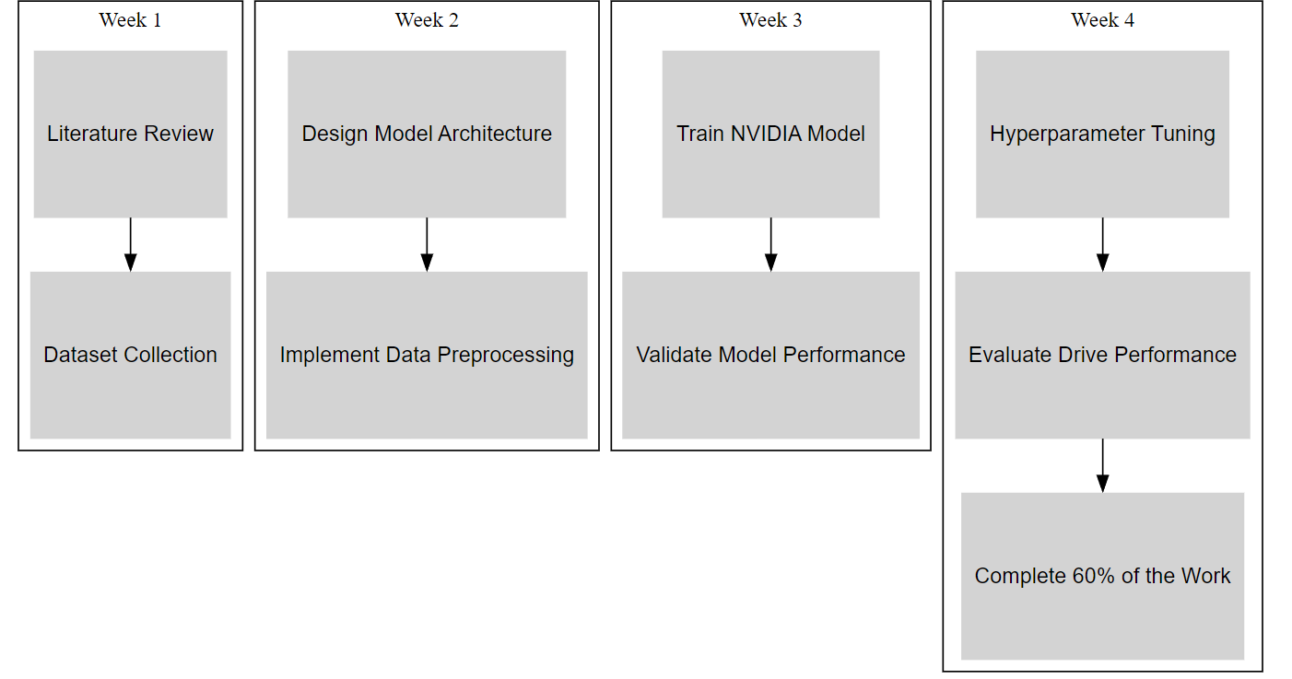
TIMELINE

Slide 19


